Slide 1
Software requirement and specifications
Passenger and driver positioning system

Slide 2
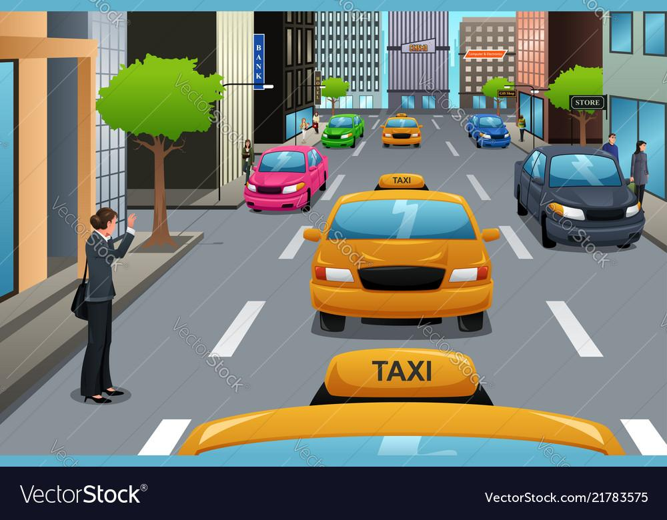
Introduction

Slide 3
Problem we are trying to solve
Avoid long waiting hours
Ensure ease of payments between drivers and passengers
Help drivers avoid overcrowded routes
Point drivers to areas with a high concentration of passengers

Slide 4
Project Requirements
Functional requirements
Non Functional requirements
Business requirements
Regulatory requirements
User requirements and
Technical requirements

Slide 5
Functional requirements
Functional requirements define the features the application must possess and functions it must perform.

Slide 6
Functional Requirements
Passenger perspective
The following are the different functional requirements from the passenger’s point of view

Slide 7

Ability to make payments through system

Slide 8
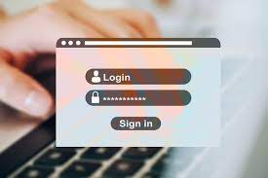
Create an account and login into the system

Slide 9
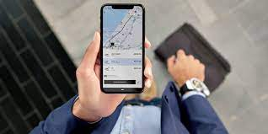
Book or cancel rides

Slide 10
Functional Requirements
Driver’s perspective
These are functionalities from the driver’s perspective

Slide 11
View distance and traffic on the road

Slide 12
Non functional requirements
Unlike functional requirements, non functional requirements describe how the system should perform instead on what it does.
Below are the non-functional requirement we came up with.

Slide 13
Performance
High performance system that will be able to handle high level of traffic on the platform

Slide 14
Scalability
In terms of scalability, the system should be able to handle 10000 passengers the same way as 100 passengers in the early days. The more the users(passengers and drivers) increase, the system should not crash

Slide 15

Security

Slide 16
Reliability
The system should be available and responsive at all times with minimal downtime and errors

Slide 17
User Requirement
Accurate and real-time positioning information
Easy to use interface for passengers
Privacy protection for user data
Compatibility with different devices and operating systems
Reliable performance in different situations

Slide 18
Regulatory requirements
This are rules a business must follow

Slide 19

Compliance with data protection and privacy laws

Slide 20
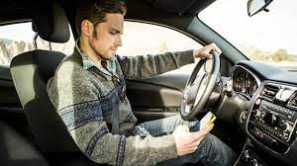
Compliance with transportation safety regulations

Slide 21

Compliance with environmental regulations and standards

Slide 22
Business requirement
For the app to keep running and proving the solutions it does, a lot of cost need to be handle. So the system also has for aim to generate revenue so as to keep operations running

Slide 23

It is not a charity
As it is not cheap to maintain many servers running and paying developers

Slide 24
Technical requirements
Technical requirements here refer to the hardware, software and infrastructure requirements of the project. And we chose to go with Mobile app and android was our choice.
So we went on to chose what will be best suit to build it and with respect to the system

Slide 25

Figma
We chosed figma to produce our design

Slide 26

React Native
We chose to go with react Native. To build our android and iOS app

Slide 27

MYSQL
The entire team has been working with MSQL right from the start of our program at FET so we are fairly good with it.

Slide 28

Azure
Azure Container Apps: We intend to host the final backend as an Azure Container application.

Slide 29
NestJS
NestJs is Nodejs framework for the backend. It runs ExpressJs under the hood and is written in typescript. Good for writing scalable and performant APIs

Slide 30
Analysis requirement
In order to make understanding of the above requirements and their specifications and in order to better analyse the system, we shared a survey with frequent passengers to get their thoughts and feelings on the entire process. We got quite a number of responses(X number to be exact). We asked passengers questions like how often they use the public transit system, their experience and what their feelings and expectations are from a digital system, in this case a mobile application that at least claims to solve the problems of the current system

Slide 31
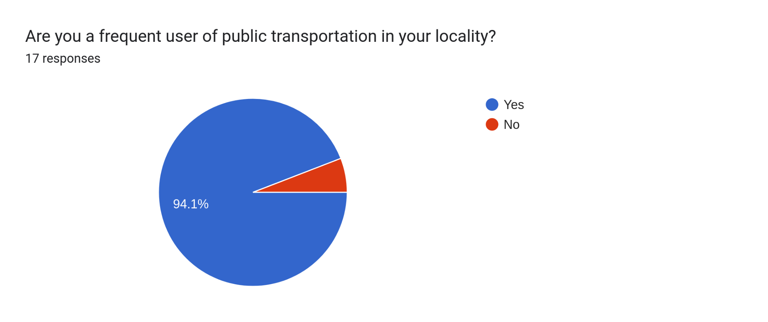
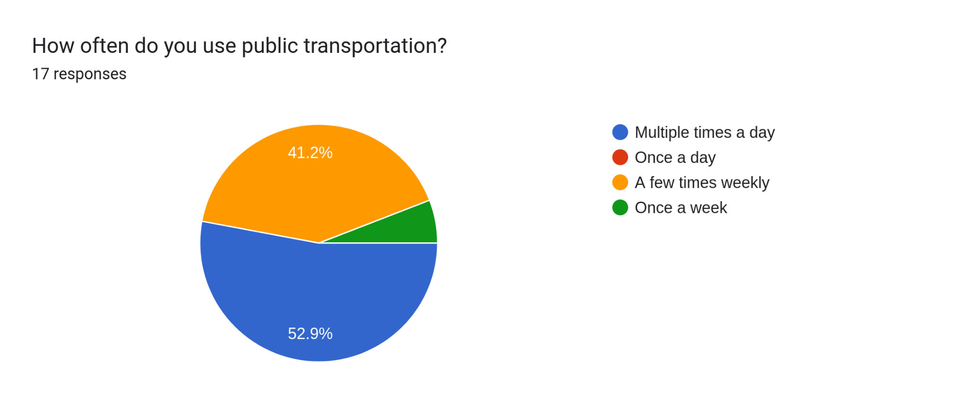
Some response from passengers

Slide 32
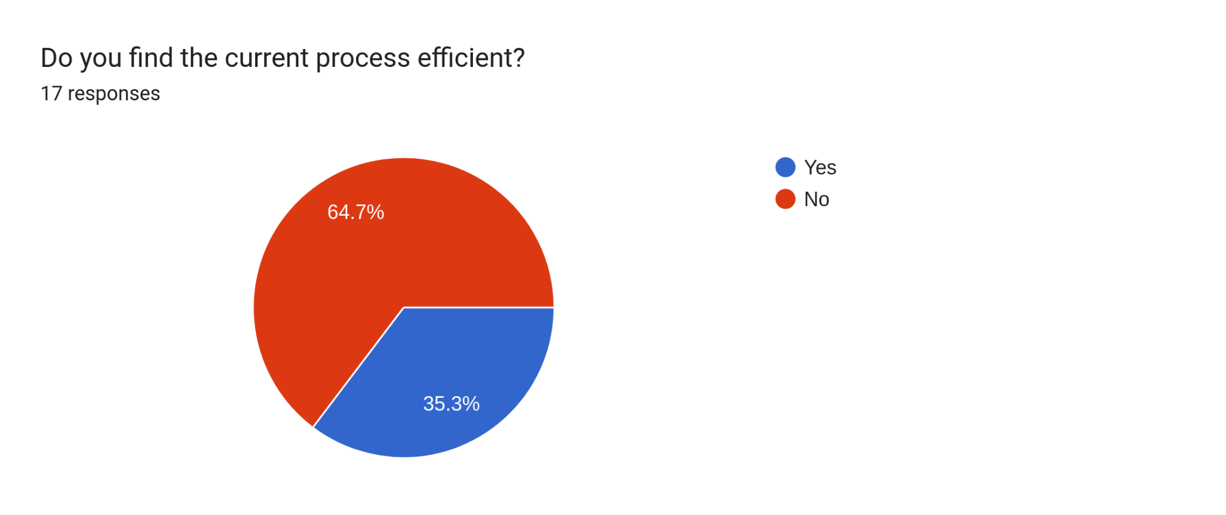
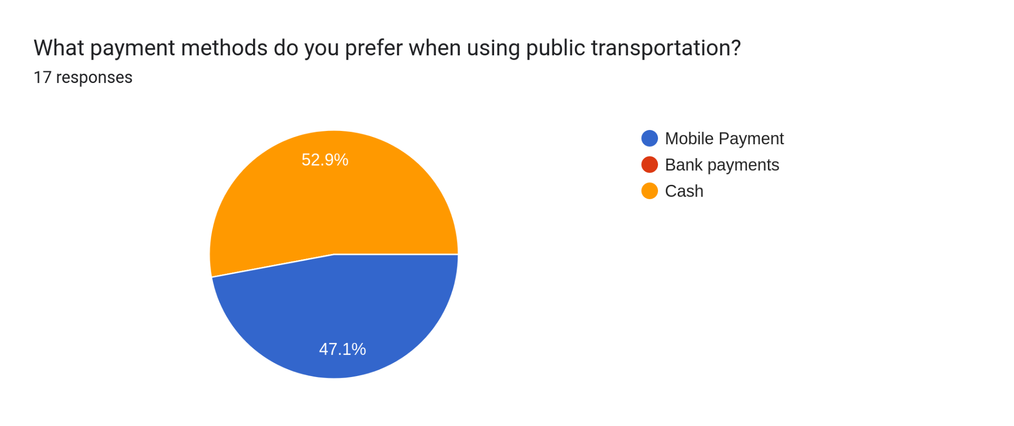
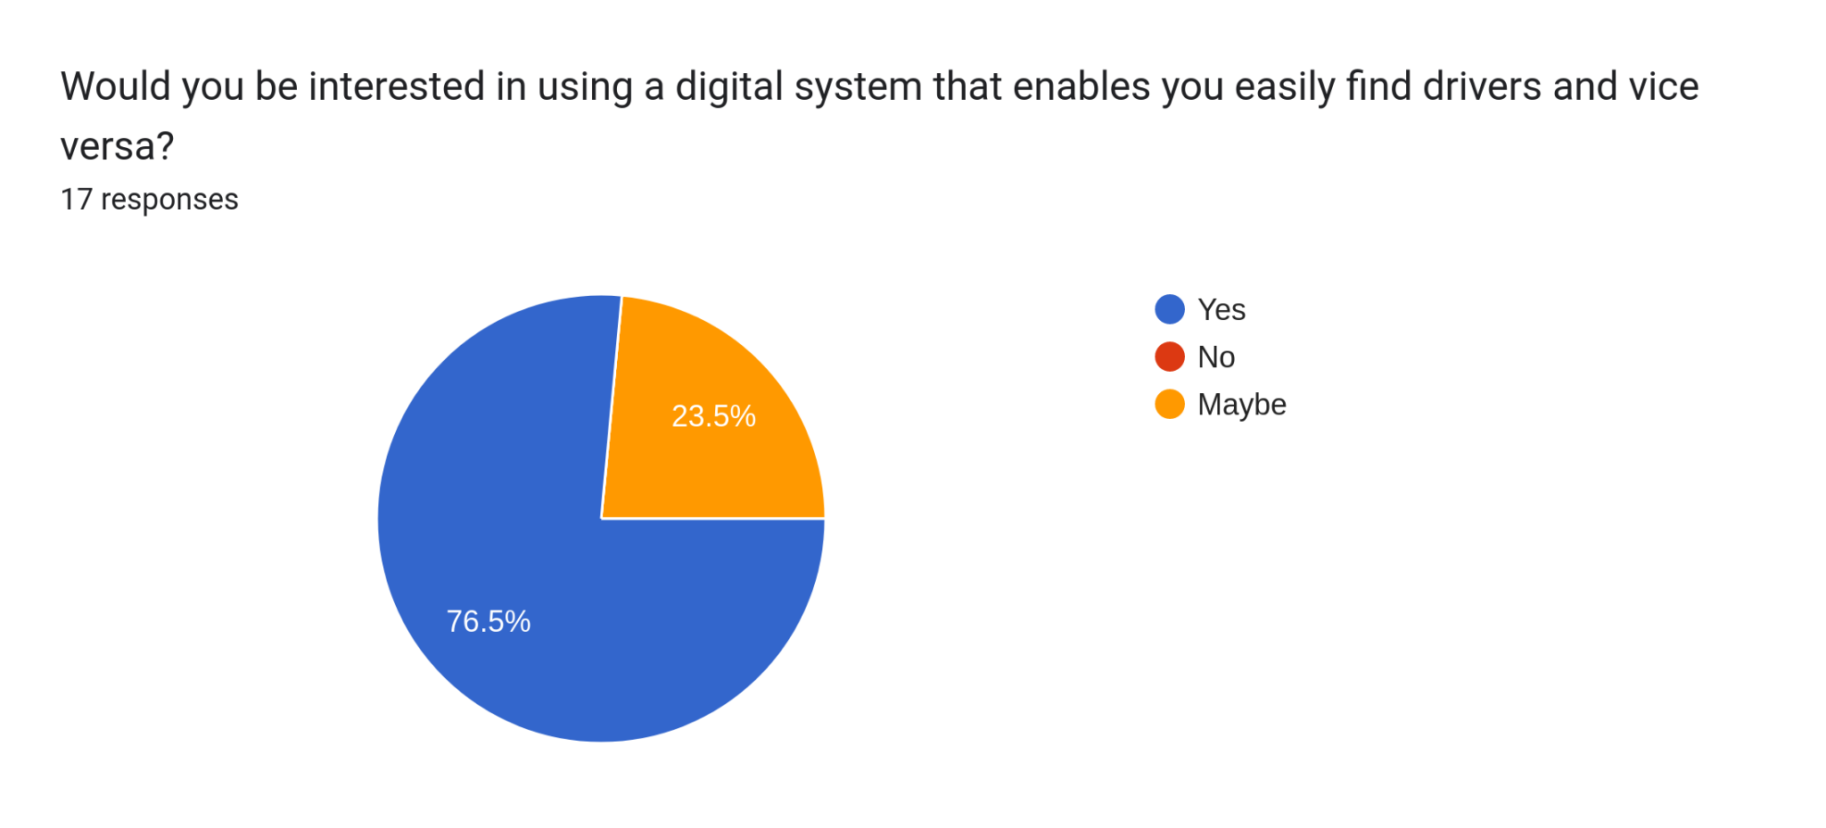

Slide 33
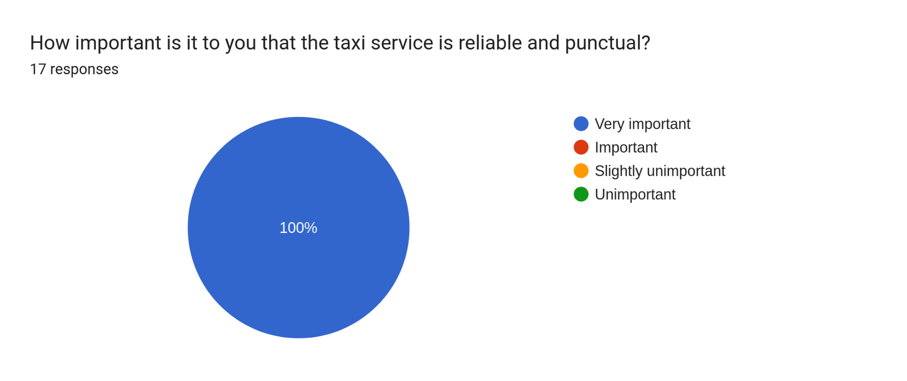
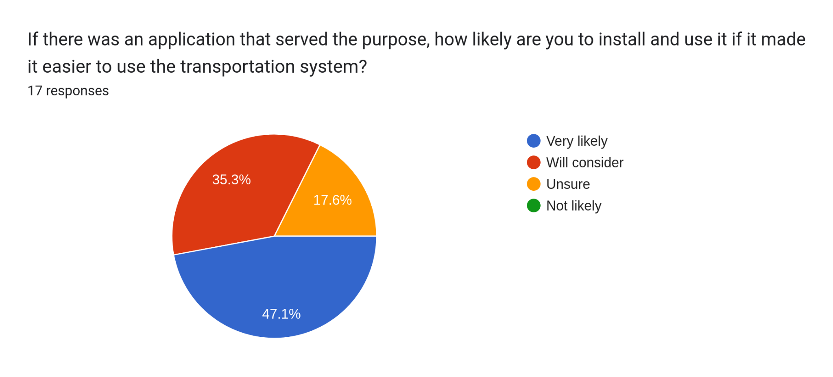
Result of Customer Survey

